Slide 1
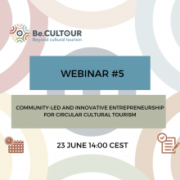
Innovative participatory and collaborative approaches to transform local communities and stakeholders into protagonists
Antonella Fresa, Promoter S.r.l.
Network Coordinator
fresa@promoter.it

Slide 2
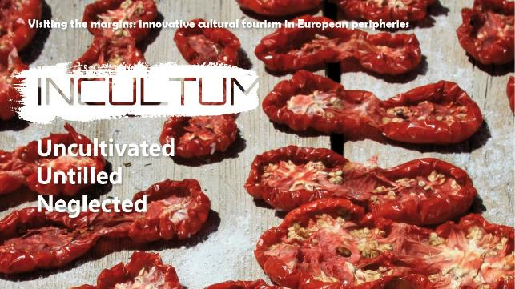
INCULTUM Visiting the margins - Innovative Cultural Tourism in European Peripheries Innovation Action Funded by the EU Under Horizon 2020 Running from 2021 until 2024 www.incultum.eu

Slide 3
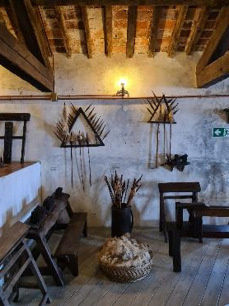
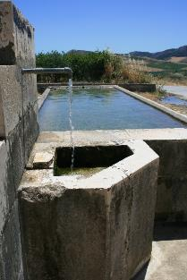
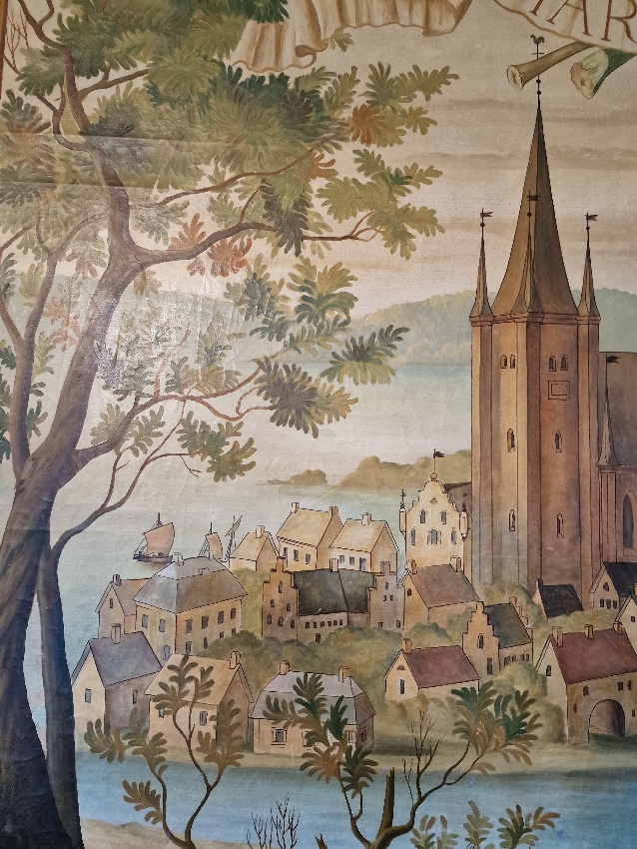
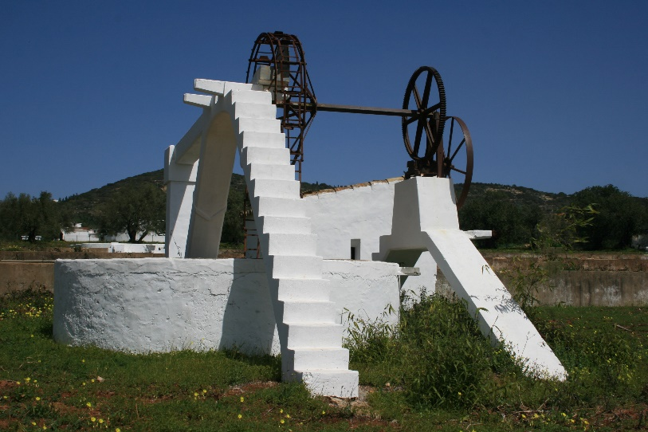
Tourism is one of the most important European economic activities and a development opportunity for territories
INCULTUM aims to conceive a novel way to develop sustainable cultural tourism in marginal or not yet know areas, focusing on
communites engagement
and
participatory approaches

Slide 4
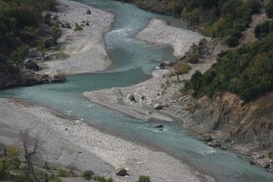
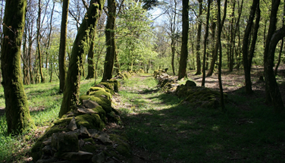
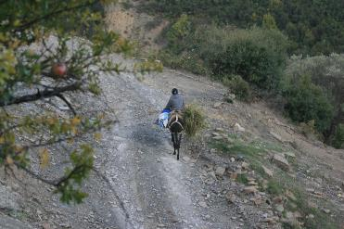
Tourism is more than travelling and consuming:
It has great potential when it comes to culture, nature and knowledge
It is a way to learn and improve oneself through personal experiences
It enriches our vision of the world and helps to improve mutual understanding
However …

Slide 5
NEGATIVE IMPACTS EXIST AT DIFFERENT LEVELS
Touristification
Gentrification
Insecurity of employment
Social tensions with residents
Reduction of the quality of visitor’s experience
…
INCULTUM KEYS TO AVOID THESE NEGATIVE IMPACTS
Adopting participatory and collaborative approaches
Transforming local communities in protagonists
Engaging stakeholders as dynamic agents of transformation

Slide 6
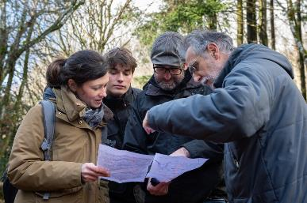
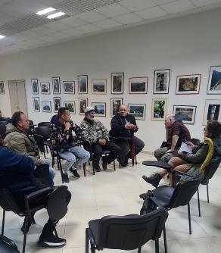
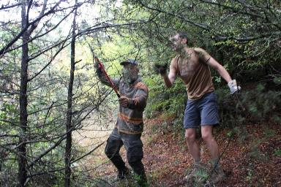
PARTICIPATION ENABLES DEVELOPMENT AND GROWTH
Local communities are engaged in valuing their territories and cultural/natural heritage
Stakeholders are involved in the co-creative management of tourism potential, developing shared marketing channels, digital tools, communication and interactivity
Policy makers establish regulations to support the promotion of the territories in collaboration with local stakeholders and communities.

Slide 7
15 partners
An interdisciplinary group of academia, municipalities, associations and SMEs participate in the INCULTUM consortium.
FUNDED BY
OFFICIAL MEDIA PARTNER

Slide 8
THREE PILLARS OF ACTION
Data GATHERING & ANALYSIS
PARTICIPATORY MODELS & POLICIES
STAKEHOLDERS MAPPING & IMPACT ASSESSMENT
Quantitative and qualitative data on cultural tourism are gathered to produce innovative data analysis.
Participatory approaches are modelled to support the engagement of local population and stakeholders as communities of practices.
Demand side (i.e. the market for cultural tourism) and supply side (i.e local economies and social life), depend on each other. Further understanding is needed to deliver actual impact.

Slide 9
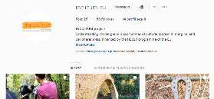
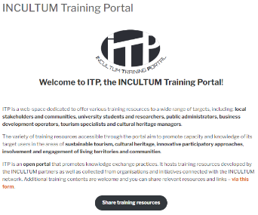
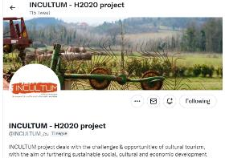
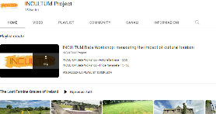
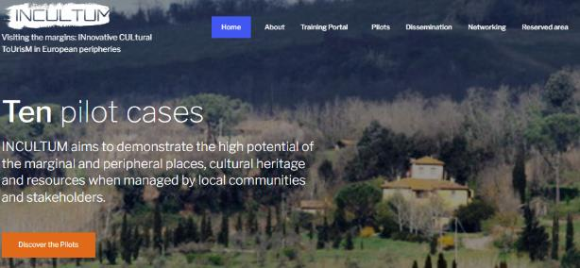
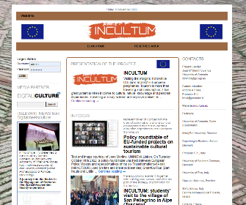
ONLINE COMMUNICATION
Social channels
Training Portal
Project’s Website
Blog

Slide 10
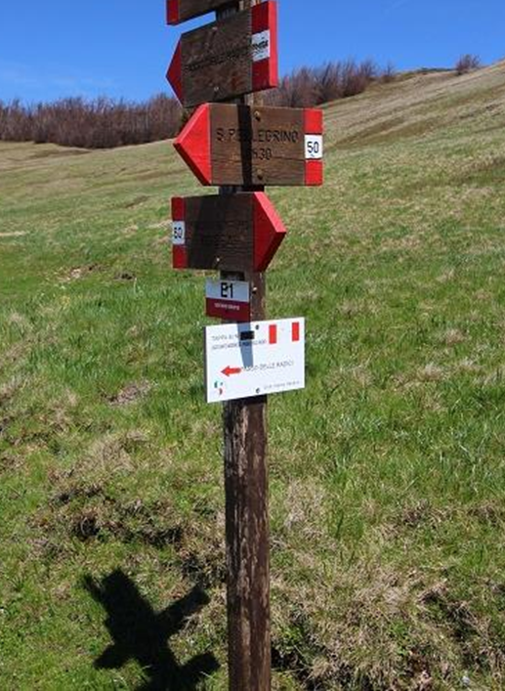
10 PILOTS ACROSS EUROPE AIM TO ENABLE COMMUNITY PARTICIPATION IN THE DEVELOPMENT OF INNOVATIVE PROPOSITIONS
Altiplano de Granada, Spain
Campina de Faro, Portugal
Copper Mines, Slovakia
Trapani Mountains, Italy
Garfagnana Appennine, Italy
Bibracte-Morvan, France
Aoos Valley, Greece
Vjosa Valley, Albania
Historic Graves, Ireland
The Archipelago Landscape, Sweden

Slide 11
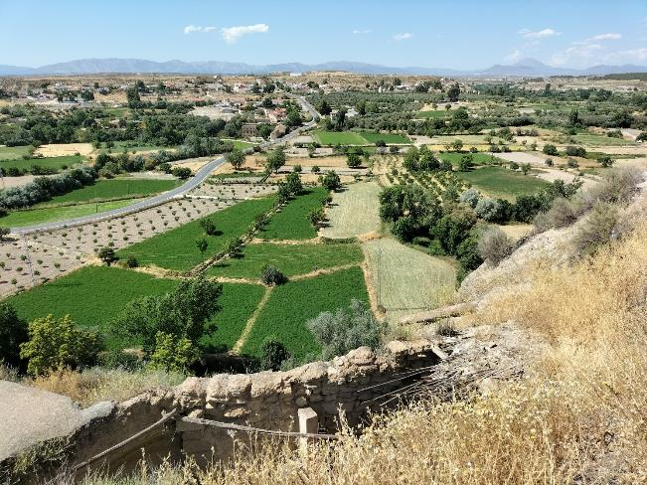
ALTIPLANO DE GRANADA

Slide 12
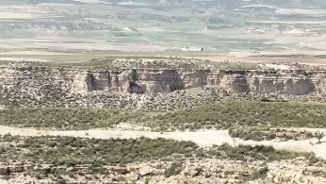
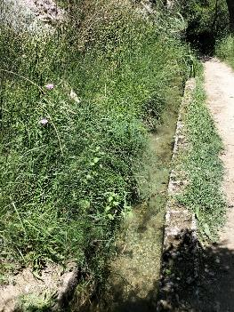
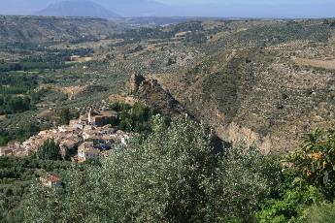
THE PLACE
North of Granada’s province, in the South-East of Spain
Flat semi-arid area with poor soils and an extreme climate due to its altitude, continental influence and the presence of surrounding mountains
Landscape marked by impressive badlands where the historical relationship between humans and the environment has built on a sustainable use of resources, particularly water and soils
Affected by a depopulation process and with one of the lowest per-capita incomes in Spain

Slide 13
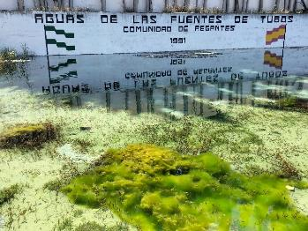
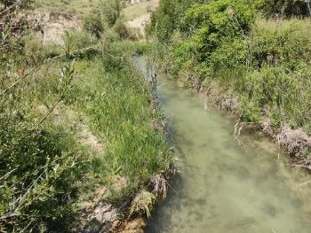
CULTURAL HERITAGE IN FOCUS
Historical irrigation systems
Dated mainly from the Middle Ages, during the Islamic period
Still in use, managed by local farmer communities
Recent proposal as Geopark, currently under evaluation by UNESCO
DANGER
Threatened by abandonment and agricultural intensification

Slide 14
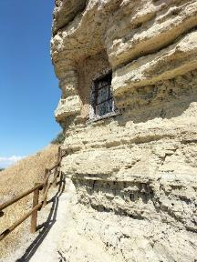
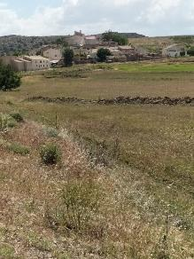
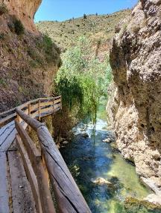
THE INCULTUM PROPOSITION
To convert existing pathways contiguous to the irrigation channels into cultural routes
To link cultural tourism to agrarian local production, rural heritage, traditional practices and ecosystem services
To interpret cultural tourism as a tool to disseminate values of the traditional agrarian spaces, binging them closer to visitors
To offer tourists a first-hand experience as they will be guided directly by the farmers

Slide 15
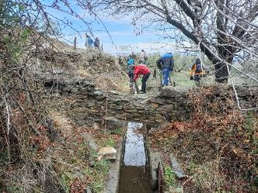
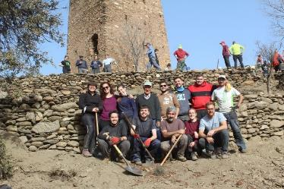
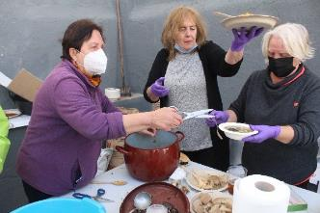
THE PARTICIPATORY APPROACH WILL ENABLE TO RETURN BENEFITS DIRECTLY TO LOCAL COMMUNITIES
The irrigator communities have a leading role in proposing, building and managing the new cultural routes
Farmers who are managing irrigation systems and who are the owners and the experts of the canals, agrarian spaces, traditional practices and their values keep control on the development and autonomy of choices, in the respect of their heritage, landscape and territory

Slide 16
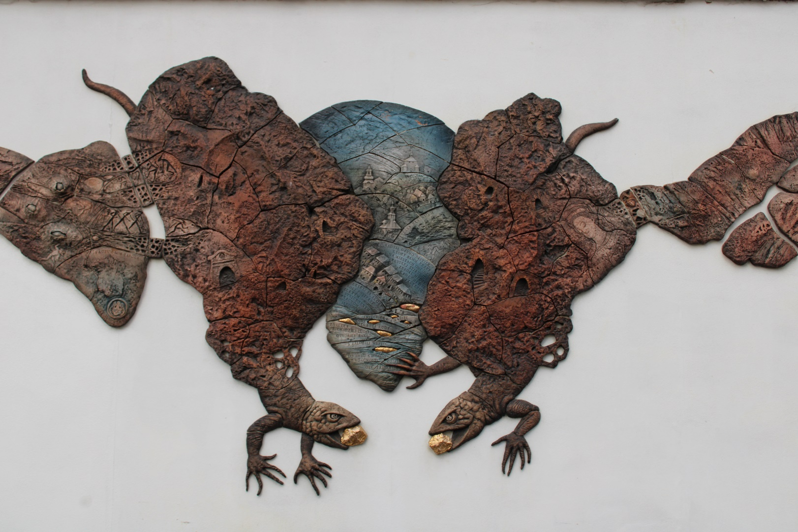
MINES IN CENTRAL SLOVAKIA

Slide 17
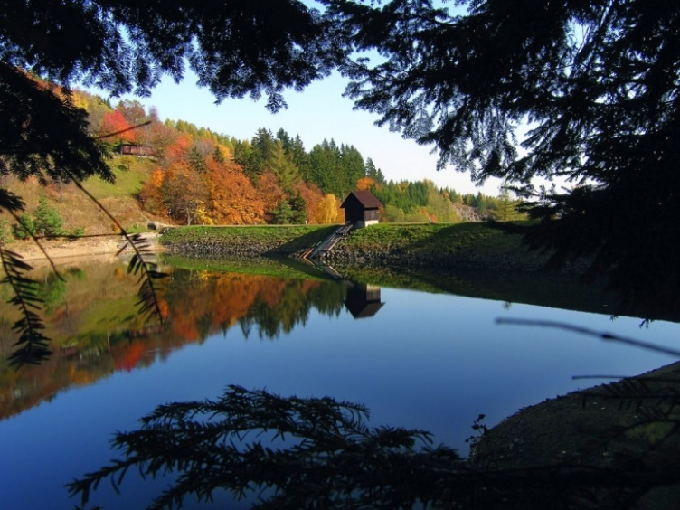
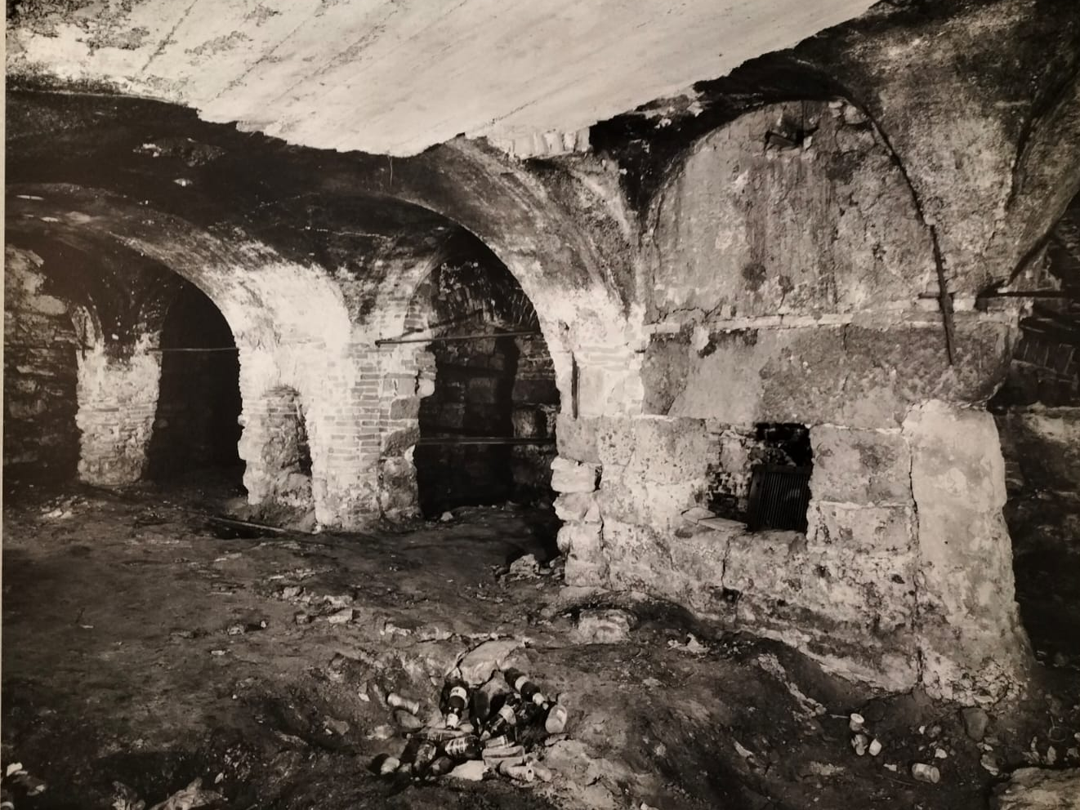
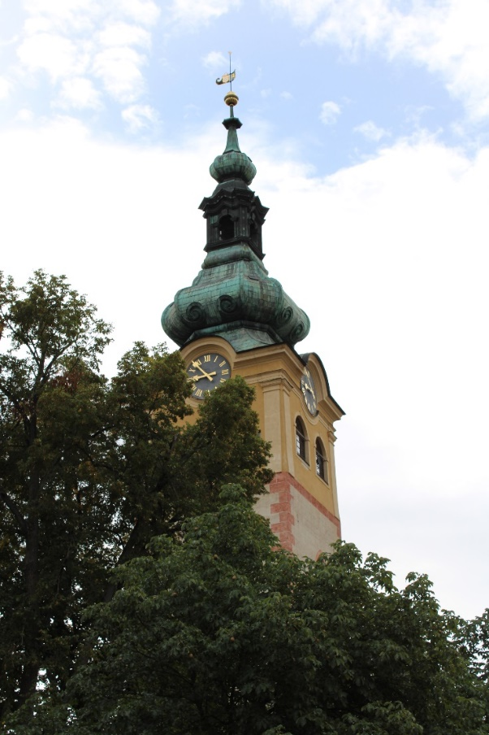
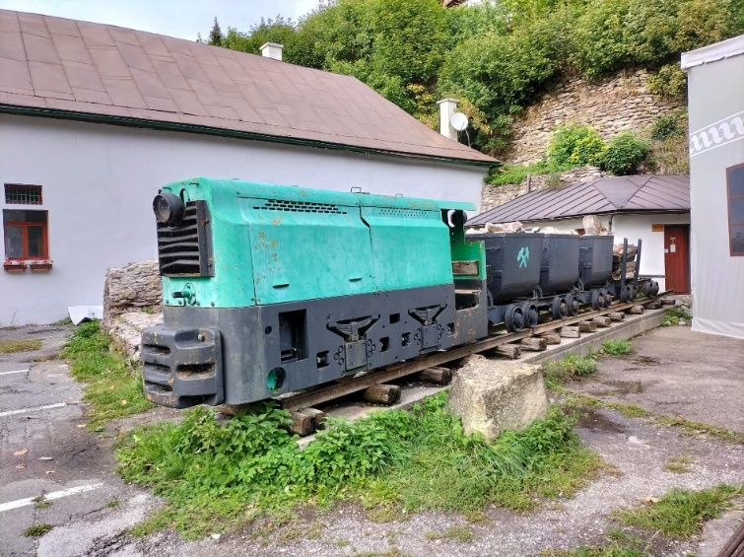
THE PLACE
The Historic Town of Banská Štiavnica (from 1993 enlisted at the UNESCO World Heritage List) is an outstanding example of important mining settlement developed since the Middle Ages.
The city of Banská Bystrica is the cultural and economic centre of Central Slovakia.
The copper mining cities acquired their present picturesque look in the Late Middle Ages when the Fugger and Thurzo families founded the prosperous, largest and most modern early-capitalist company of that time.

Slide 18
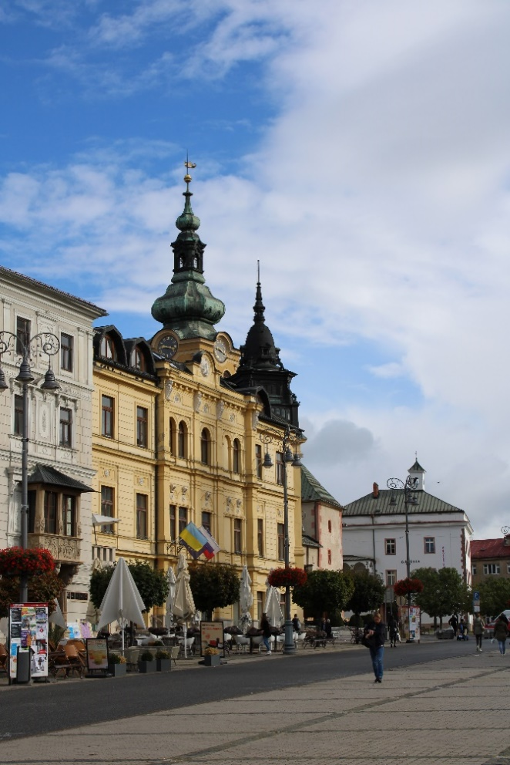
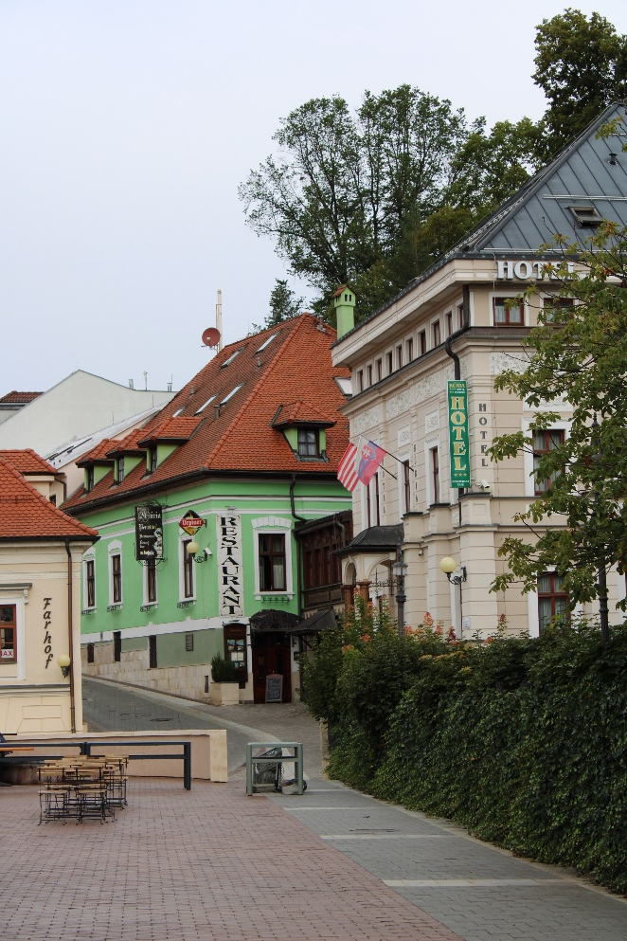
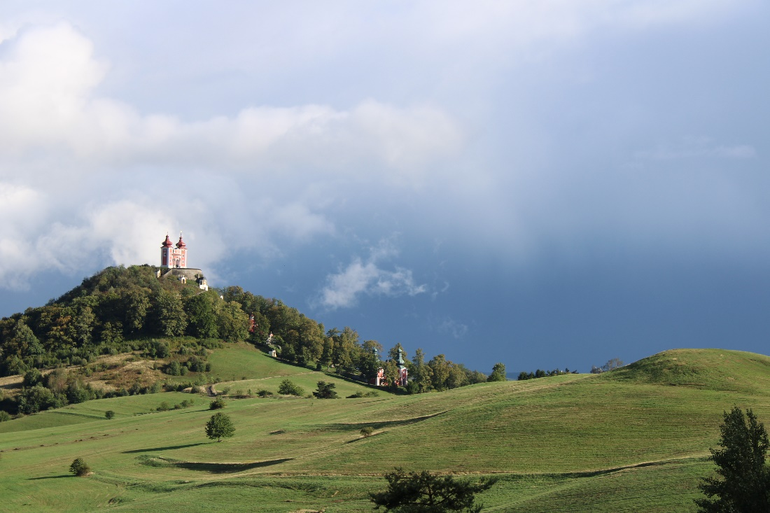
CULTURAL HERITAGE IN FOCUS
Significant cultural and technical heritage in the territory relates to its mining history.
DANGER
Although the Banská Bystrica region plays an important role in the tourism in Slovakia being part of two important tourism routes (the Barbora Route and the European Fugger Route), the city significantly lacks marketing and digital tools promoting this unique part of its history.

Slide 19
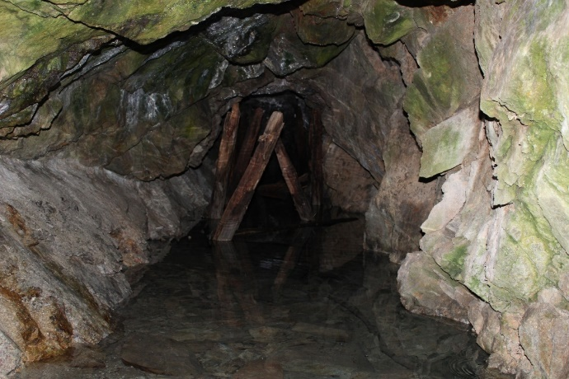
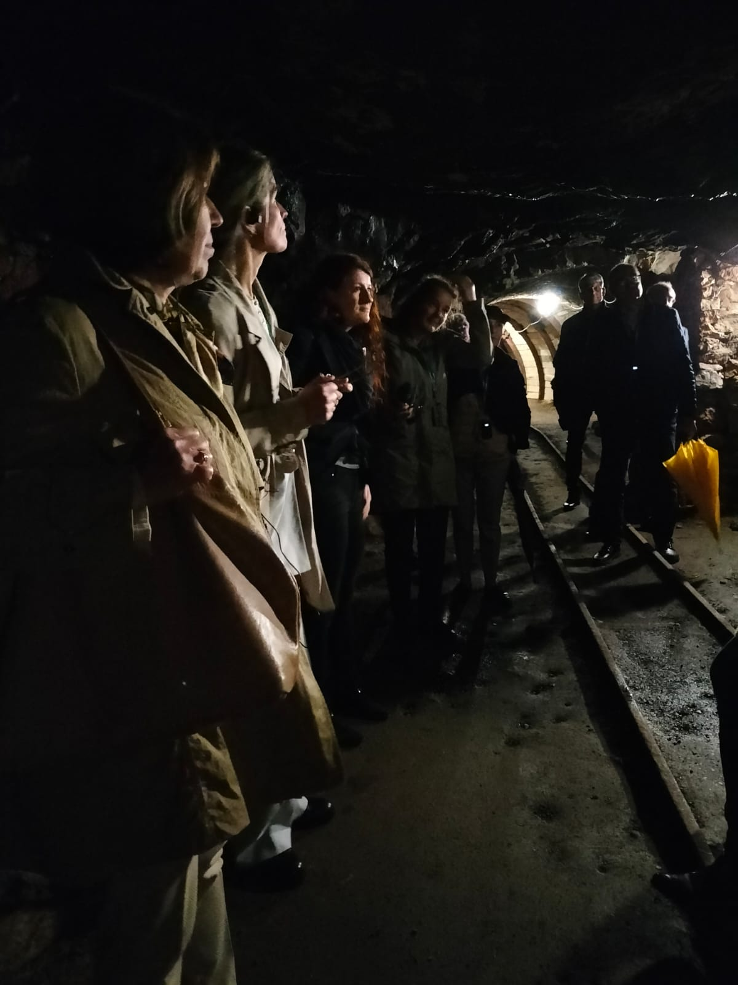
THE INCULTUM PROPOSITION
“Mining Treasures of Central Slovakia”, a participatory interactive digital map with a twofold scope: to promote lesser-known mining monuments and mining heritage sites, and to educate children, young people and the general public in this area about their local history
Visual identity and logo of the website were selected via a local contest
Participation of stakeholders and students of tourism promotion in the process of content creation
Engagement of local communities called to contribute with pictures from their family albums and stories of their families

Slide 20
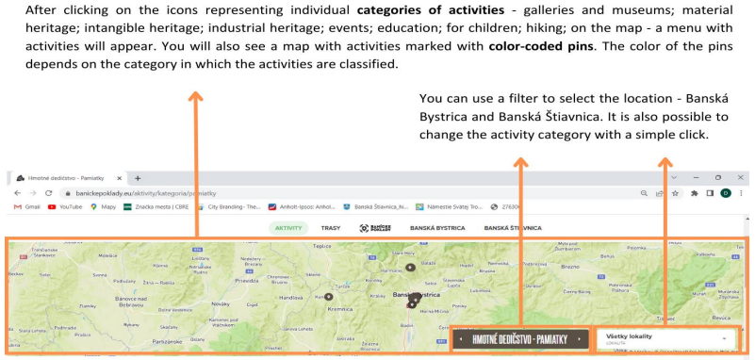
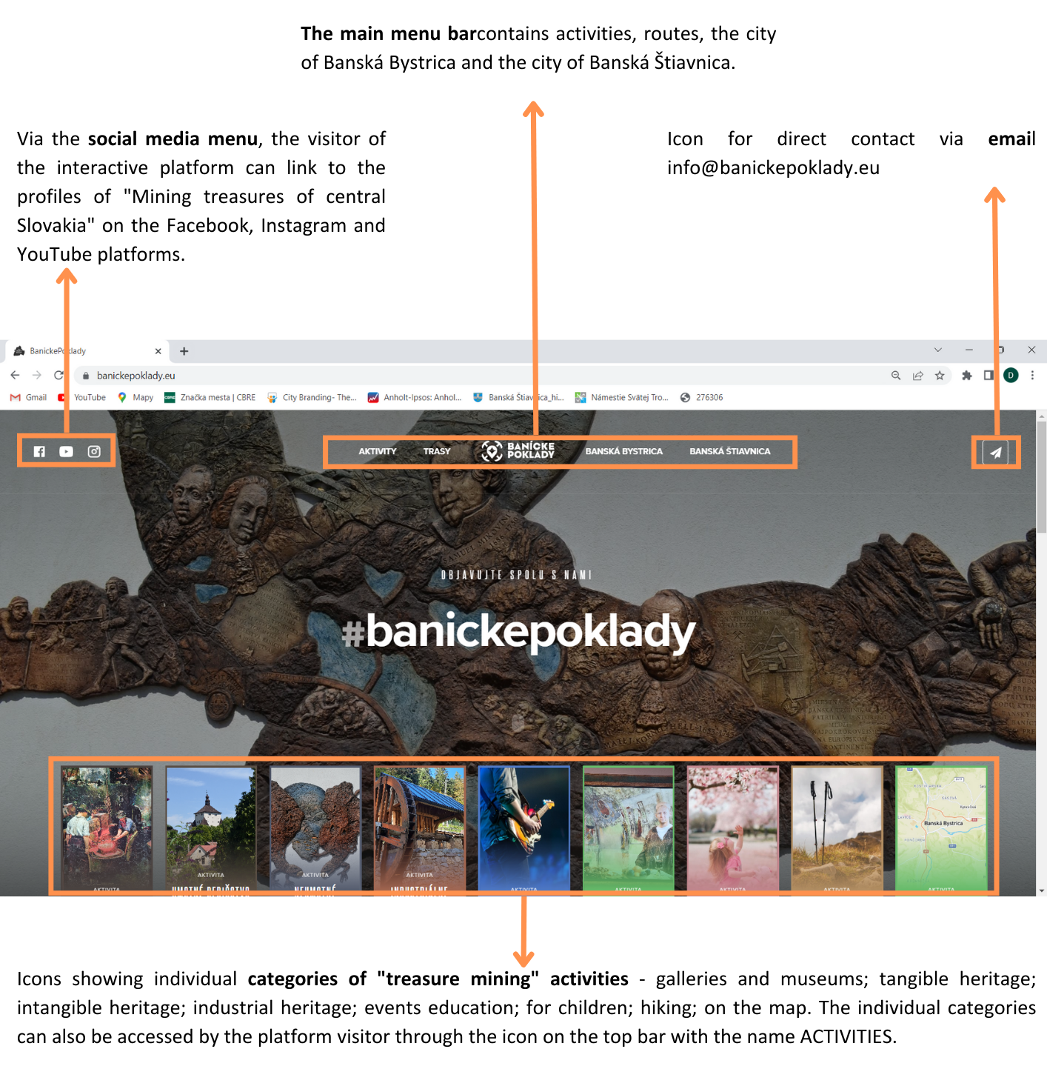

Slide 21
An innovation is:
Something new / an invention
Incremental (improvement of the existing) or radical (in-depth transformation)
Emerging in a given context
Spreading through encounters with users (who improve it, make it evolve)
Leading to a change in practices and social norms
NB: If it is not adopted by the greatest number of people, the invention will not be an innovation
THE CHALLENGES FOR THE COMING MONTHS
To extend the adoption of the pilot propositions to the largest number of participants at local level
To gain the support of policy makers
To plan the economic sustainability of the actions
To continue and strengthen communication, dissemination, promotion and training as mechanisms to attract attention and create the conditions for further deployments

Slide 22
CONTACTS
Website: www.incultum.eu
Project’s blog: www.digitalmeetsculture.net/projects/incultum-blog/
E-mail: info@incultum.eu
Network Coordinator: Antonella Fresa, Promoter S.r.l.
Project Coordinator and leader of the pilot Altiplano de Granada: José Maria Civantos, University of Granada MEMOLab Laboratorio de Arqueología Biocultural
Participatory models and leader of the pilot Mining Treasures in Central Slovakia: Alexsandra Bitusikova and Kamila Borsekova, Matej Bell University

Slide 23
THANKS FOR YOUR ATTENTION!
All the images in this presentation are courtesy of the INCULTUM partners
Specific licenses and rights may apply.

